Slide 1
Figures – Chapter 10

Slide 2
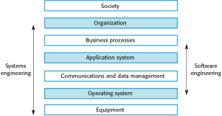
Figure 10.1 The sociotechnical systems stack

Slide 3
Figure 10.2 Examples of emergent properties
Property | Description
Volume | The volume of a system (the total space occupied) varies depending on how the component assemblies are arranged and connected.
Reliability | System reliability depends on component reliability but unexpected interactions can cause new types of failures and therefore affect the reliability of the system.
Security | The security of the system (its ability to resist attack) is a complex property that cannot be easily measured. Attacks may be devised that were not anticipated by the system designers and so may defeat built-in safeguards.
Repairability | This property reflects how easy it is to fix a problem with the system once it has been discovered. It depends on being able to diagnose the problem, access the components that are faulty, and modify or replace these components.
Usability | This property reflects how easy it is to use the system. It depends on the technical system components, its operators, and its operating environment.

Slide 4
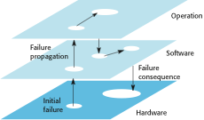
Figure 10.3 Failure propagation

Slide 5
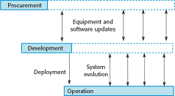
Figure 10.4 Stages of systems engineering

Slide 6
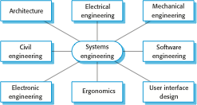
Figure 10.5 Professional disciplines involved in systems engineering

Slide 7
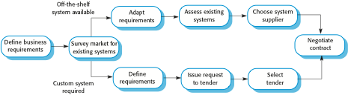
Figure 10.6 System procurement processes

Slide 8
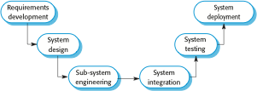
Figure 10.7 Systems development

Slide 9
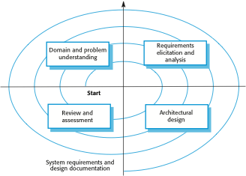
Figure 10.8 Requirements and design spiral

Slide 10
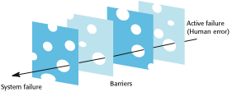
Figure 10.9 Reason’s Swiss cheese model of system failure

